Slide 1

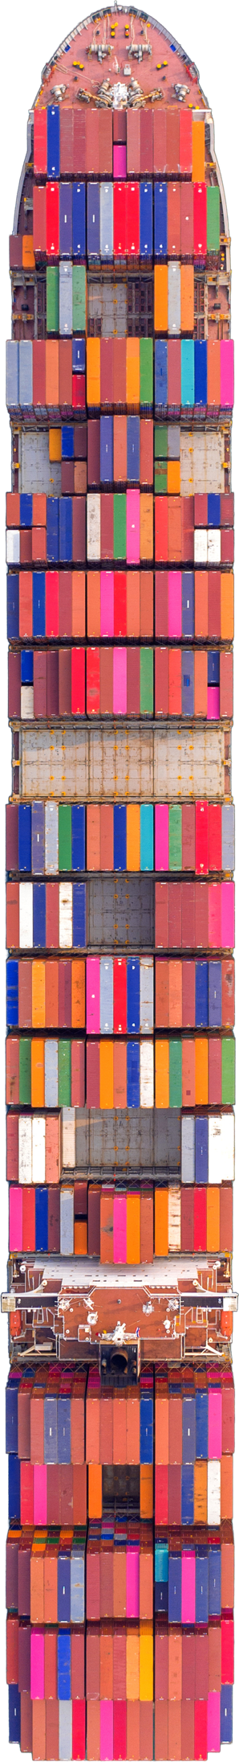
The shipping container went global in the 1970s
Notes:
Global trade solved the movement of goods decades ago.
Containers standardised logistics worldwide.
But information flows never evolved at the same pace.
Why this slide
Sets historical context without blame.
Frames the problem as structural, not operational failure.

Slide 2



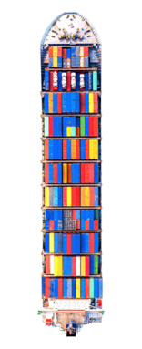
The data and documents never caught up
The shipping container went global in the 1970s
Notes:
Trade still relies heavily on paper, emails, and PDFs.
Data moves slower than goods.
That gap is where delays, disputes, and cost creep in.
Transition line
“This gap between physical logistics and data is where most trade friction lives.”

Slide 3


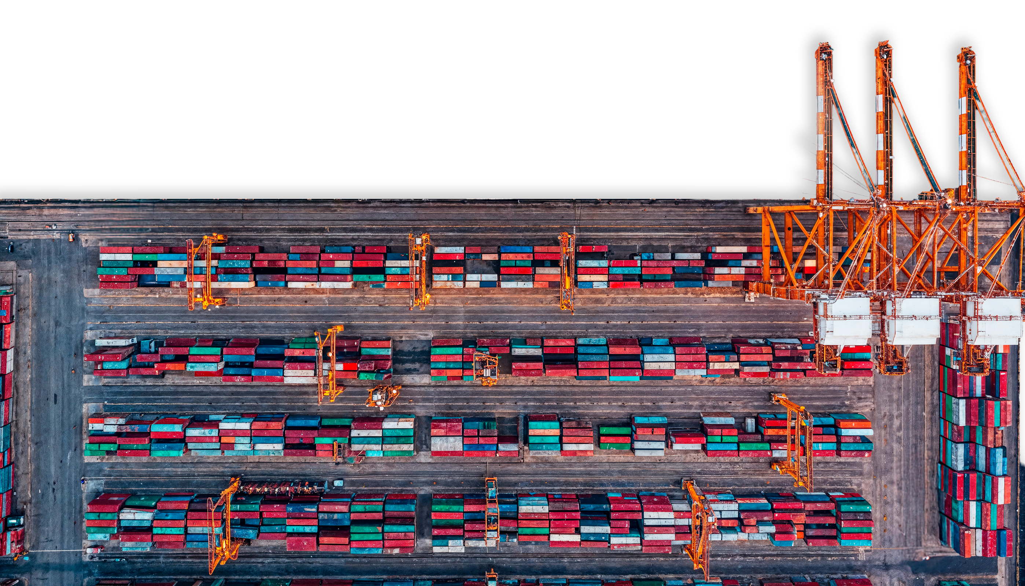



Global physical trade is vast
~US$26T/year
The data and documents never caught up
~50 paper documents
Per shipment
exchanged with up to
~30 stakeholders
>28.5B paper documents printed annually

Slide 4
Global physical trade is vast
~US$26T/year
~50 paper documents
Per shipment
exchanged with up to
~30 stakeholders
>28.5B paper documents printed annually
Notes:
~US$26 trillion of trade annually.
Around 50 documents per shipment.
Up to 30 stakeholders per movement.
Over 28 billion paper documents printed every year.
Why this matters
Even small inefficiencies scale into massive cost and risk.
This isn’t niche, it’s systemic.

Slide 5

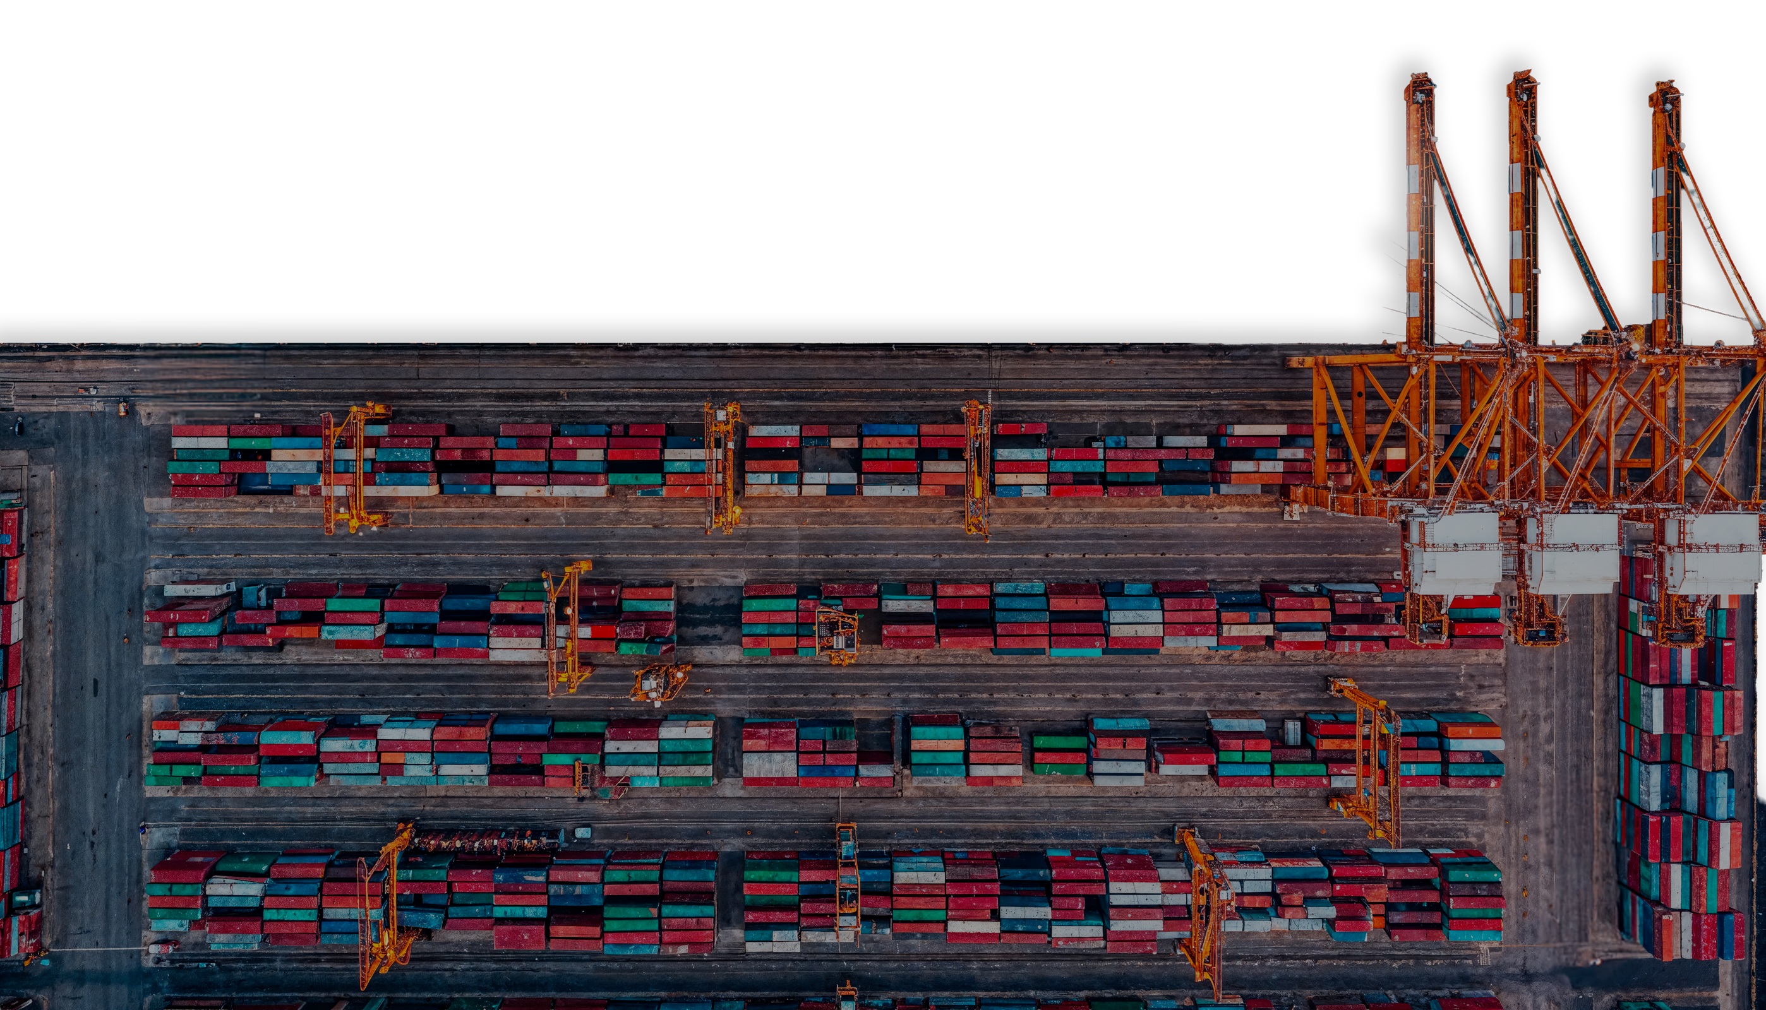
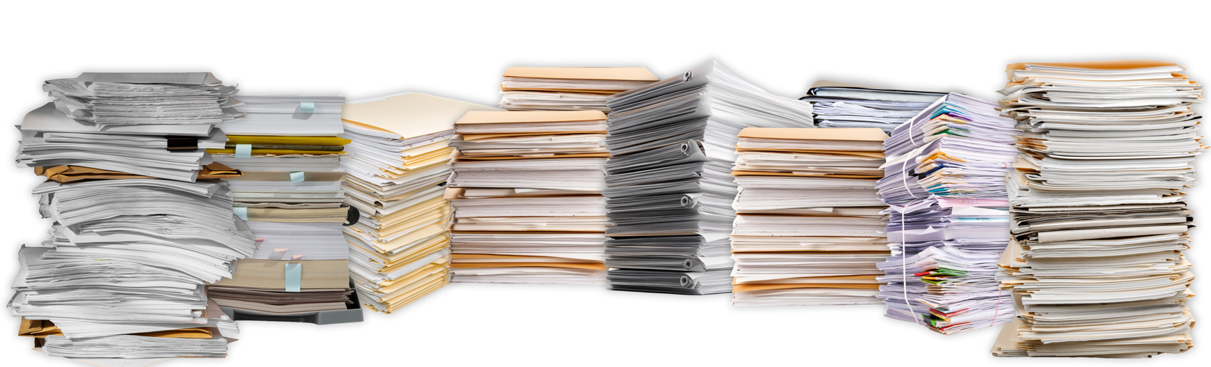
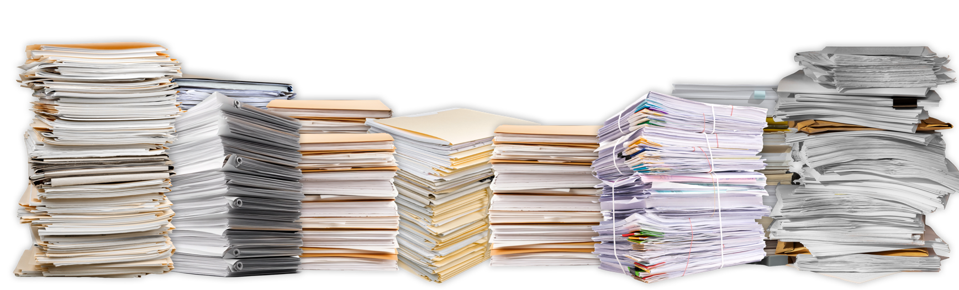
Trade & Logistics is complex,
Global physical trade is vast
~US$26T/year
“Trade is modern logistics
wrapped in legacy paperwork.”
~50 paper documents
Per shipment
exchanged with up to
~30 stakeholders
>28.5B paper documents printed annually
with fragmented, duplicated, untrusted data.
Notes:
Trade today is highly optimised physically.
Information management is still manual and fragmented.
The complexity isn’t the goods — it’s the data.

Slide 6

Trade & logistics is complex,
CTO
SUPPLY CHAIN
MANAGER
BUSINESS
OWNER
WAREHOUSE
MANAGER
CEO
“Trade is modern logistics
wrapped in legacy paperwork.”
Trade & logistics is complex,
with fragmented, duplicated, untrusted data.
with many stakeholders,
and one core problem: Data
Data
Notes:
Multiple versions of the same document exist at once.
No single party sees the full picture.
Disputes happen because data isn’t trusted or aligned.
Key emphasis
This is not a technology failure.
It’s a coordination and trust problem.

Slide 7

Trade & logistics is complex,
CEO
WAREHOUSE
MANAGER
BUSINESS
OWNER
SUPPLY CHAIN
MANAGER
CTO
with many stakeholders,
and one core problem: Data
Data
Notes:
CEOs, operators, IT teams, business owners, all feel this differently.
But the root cause is the same: unreliable data flow.
Everyone compensates manually

Slide 8





Data
Adam
Bob
Claire
Dana
Erik
CEO
Needs confidence to modernise without risking disruption, reputation, or board trust.
WAREHOUSE
MANAGER
Needs fewer re-keys, fewer escalations, and systems that support the floor instead of slowing it down.
BUSINESS
OWNER
MSME Business Owner: Needs speed, simplicity, and affordability — without enterprise complexity or paperwork loops.
SUPPLY CHAIN
MANAGER
Needs earlier signals, verifiable milestones, and a shared record to protect cost, uptime, and performance.
CTO
Needs secure, interoperable architecture that integrates cleanly, scales reliably, and doesn’t become technical debt.
Notes:
Leaders need confidence to modernise without disruption.
Operators need fewer re-keys and escalations.
IT needs secure, interoperable systems that don’t create debt.
Business owners need speed without enterprise complexity.
Supply chain leaders need early signals and shared records.
Why this slide
Shows LogChain understands people, not just platforms and processes.

Slide 9



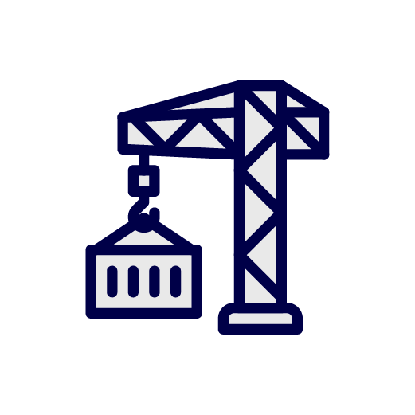
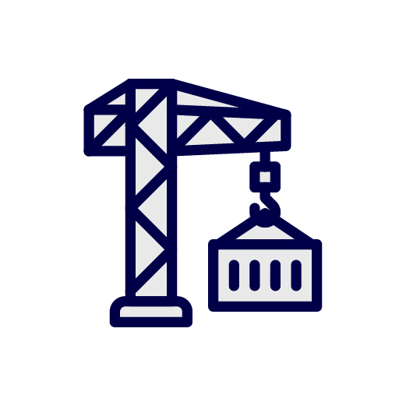



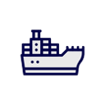











Trade & logistics is complex,
MOVEMENT OF GOODS
MANAGEMENT OF DATA
with fragmented, duplicated, untrusted data.
Notes:
Complexity is not inevitable.
What’s missing is a shared, trusted operational record.
When data is aligned, trade simplifies naturally.

Slide 10
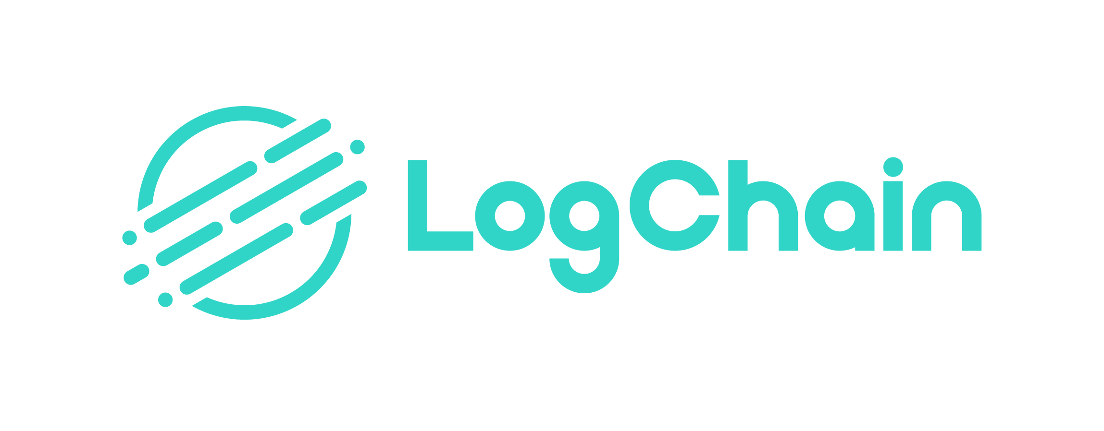
Trade & logistics is complex,
with fragmented, duplicated, untrusted data.

Slide 11
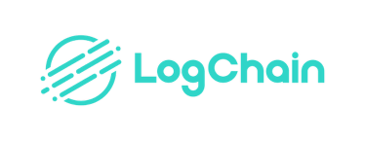


Trade & logistics is complex,
Trade & logistics does not have to be complex…
…with one shared truth.
with fragmented, duplicated, untrusted data.
A Global First in Trade
From analogue to automated — without disrupting a single system.
The World’s First Fully Digital Trade Shipment
Zero Paper
The Problem
Trade workflows still rely on paper, emails, and manual clearance.
Even trusted exporters face duplicated processes and delays.
Regulatory complexity slows down cross-border movement.
From analogue to automated — without disrupting a single system.
The Solution
Fort Vale used LogChain to fully digitalise a UK–Singapore shipment.
All documents handled digitally — no paper, no couriers.
Real-time access to a single source of truth across all parties.
Notes:
From analogue to automated — without disrupting a single system
Talking points
Most organisations can’t afford “rip and replace”.
Digital trade must work with existing systems.
The goal is progress without operational shock.
Key phrase to land
“Modernisation without disruption.”

Slide 12





A Global First in Trade
The World’s First Fully Digital Trade Shipment
Zero Paper
The Problem
Trade workflows still rely on paper, emails, and manual clearance.
Even trusted exporters face duplicated processes and delays.
Regulatory complexity slows down cross-border movement.
The Solution
Fort Vale used LogChain to fully digitalise a UK–Singapore shipment.
All documents handled digitally — no paper, no couriers.
Real-time access to a single source of truth across all parties.
From analogue to automated — without disrupting a single system.
Media Coverage
Results
A world first in nearly 5,500 years of global trade
Zero paper used end-to-end.
Full customs clearance on both sides.
Recognised by UK Government, UN, WTO, Global Press.
Notes:
This isn’t theory — it’s the world’s first end-to-end digitalised shipment, executed with full regulator acceptance across two jurisdictions. It proves LogChain’s model works — in practice, at scale, and under scrutiny.
The challenge wasn’t technology — it was coordination.
LogChain created a single shared record across all parties.
Everyone worked from the same trusted data, in real time.

Slide 13
The Problem
Trade workflows still rely on paper, emails, and manual clearance.
Even trusted exporters face duplicated processes and delays.
Regulatory complexity slows down cross-border movement.
The Solution
Fort Vale used LogChain to fully digitalise a UK–Singapore shipment.
All documents handled digitally — no paper, no couriers.
Real-time access to a single source of truth across all parties.
From analogue to automated — without disrupting a single system.
A Global First in Trade
The World’s First Fully Digital Trade Shipment
Zero Paper
Results
A world first in nearly 5,500 years of global trade
Zero paper used end-to-end.
Full customs clearance on both sides.
Recognised by UK Government, UN, WTO, Global Press.
Media Coverage
“Digitalised trade will make it quicker, cheaper and easier for firms to do business around the world. This is a landmark moment for the future of international trade.”
Minister for International Trade
Notes:
Zero paper end-to-end.
Full customs clearance on both sides.
Recognised by governments and global institutions.
Why it matters
This wasn’t a lab test.
It happened in live trade conditions.

Slide 14

Results
Media Coverage
A world first in nearly 5,500 years of global trade
Zero paper used end-to-end.
Full customs clearance on both sides.
Recognised by UK Government, UN, WTO, Global Press.
A Global First in Trade
The World’s First Fully Digital Trade Shipment
Zero Paper
“Digitalised trade will make it quicker, cheaper and easier for firms to do business around the world. This is a landmark moment for the future of international trade.”
Minister for International Trade
Yes, blockchain. Not crypto.
What LogChain is:
Private, permissioned network (Hyperledger Fabric)
No token economics
Known counterparties + governed rules
Audit-ready, real-time data sharing
What it is not:
Public chain
Tokens / volatility
Anonymous participants
Speculation-driven incentives
Notes:
This marks a shift in how trade can operate.
Digital trade is moving from concept to infrastructure.
Governments now expect audit-grade digital records.

Slide 15


A Global First in Trade
The World’s First Fully Digital Trade Shipment
Zero Paper
“Digitalised trade will make it quicker, cheaper and easier for firms to do business around the world. This is a landmark moment for the future of international trade.”
Minister for International Trade
Yes, blockchain. Not crypto.
What LogChain is:
Private, permissioned network (Hyperledger Fabric)
No token economics
Known counterparties + governed rules
Audit-ready, real-time data sharing
What it is not:
Public chain
Tokens / volatility
Anonymous participants
Speculation-driven incentives
Infrastructure,
Not Interface.
Trust, Not Noise.
LogChain is a web and mobile SaaS platform that digitalises, automates, and secures global trade flows.
It works quietly in the background — integrating with existing systems to streamline operations and give everyone access to a single, trusted version of the truth.
Built for people. Proven in the field. Powered by blockchain — but without the crypto noise.
Notes:
Yes, we use blockchain, but not crypto. LogChain runs on Hyperledger Fabric, a private permissioned ledger. No tokens, no wallets, just an immutable audit trail and controlled real-time sharing across approved trade partners.
The difference is governance. Public chains optimise for open participation; we optimise for accountability: known counterparties, permissions, and auditability. That’s why it works for regulated trade environments.

Slide 16

Yes, blockchain. Not crypto.
What LogChain is:
Private, permissioned network (Hyperledger Fabric)
No token economics
Known counterparties + governed rules
Audit-ready, real-time data sharing
What it is not:
Public chain
Tokens / volatility
Anonymous participants
Speculation-driven incentives
Infrastructure,
Not Interface.
Trust, Not Noise.
We’re building the infrastructure others will build on, staying neutral, interoperable, and scalable.
LogChain is a web and mobile SaaS platform that digitalises, automates, and secures global trade flows.
It works quietly in the background — integrating with existing systems to streamline operations and give everyone access to a single, trusted version of the truth.
Built for people. Proven in the field. Powered by blockchain — but without the crypto noise.
Digitalise. Automate. Secure. Share.
Capture Once
Digital forms, e-signatures, inspections — all recorded at the point of origin
Share with Confidence
Every party sees the same truth — no duplicates, no ambiguity
Secure by Design
Blockchain-backed records: immutable, auditable, regulator-trusted
Automate the Routine
Smart triggers route tasks, approvals, and alerts in real time
Integrate Seamlessly
API-first platform that works with your current systems — no rip-and-replace
Notes:
LogChain works quietly in the background.
We don’t replace your systems.
We connect them with a trusted data layer.

Slide 17

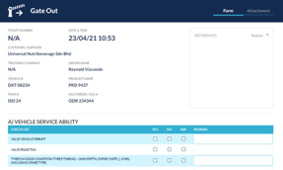

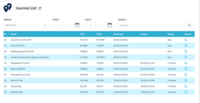
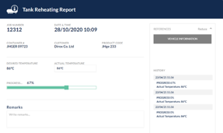
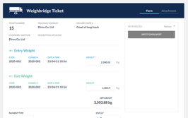
Infrastructure,
Not Interface.
Trust, Not Noise.
LogChain is a web and mobile SaaS platform that digitalises, automates, and secures global trade flows.
It works quietly in the background — integrating with existing systems to streamline operations and give everyone access to a single, trusted version of the truth.
Built for people. Proven in the field. Powered by blockchain — but without the crypto noise.
We’re building the infrastructure others will build on, staying neutral, interoperable, and scalable.
Digitalise. Automate. Secure. Share.
LogChain:
Built for people. Designed for progress.
Capture Once
Digital forms, e-signatures, inspections — all recorded at the point of origin
Share with Confidence
Every party sees the same truth — no duplicates, no ambiguity
Secure by Design
Blockchain-backed records: immutable, auditable, regulator-trusted
Automate the Routine
Smart triggers route tasks, approvals, and alerts in real time
Integrate Seamlessly
API-first platform that works with your current systems — no rip-and-replace
Proven Adoption: User-friendly interfaces validated through real-world use
Seamless Integration: Works with existing systems — no rip-and-replace
Real-Time Visibility: One source of truth across every stakeholder
Blockchain Audit Trails: Secure, immutable, regulator-trusted
Workflow Automation: Reduces manual work, increases team productivity
Human-Centred Design: Built for operators, managers, and executives alike
Notes:
Capture data once, at source.
Share confidently across approved parties.
Secure every step with audit-ready records.
Automate routine workflows.
Integrate via APIs — no rip and replace.

Slide 18
Digitalise. Automate. Secure. Share.
Capture Once
Digital forms, e-signatures, inspections — all recorded at the point of origin
Share with Confidence
Every party sees the same truth — no duplicates, no ambiguity
Secure by Design
Blockchain-backed records: immutable, auditable, regulator-trusted
Automate the Routine
Smart triggers route tasks, approvals, and alerts in real time
Integrate Seamlessly
API-first platform that works with your current systems — no rip-and-replace
LogChain:
Built for people. Designed for progress.
Proven Adoption: User-friendly interfaces validated through real-world use
Seamless Integration: Works with existing systems — no rip-and-replace
Real-Time Visibility: One source of truth across every stakeholder
Blockchain Audit Trails: Secure, immutable, regulator-trusted
Workflow Automation: Reduces manual work, increases team productivity
Human-Centred Design: Built for operators, managers, and executives alike
User Journey:
From First Click to Verified Record
Whether you’re Adam, Bob, or Claire, LogChain simplifies your day.

Slide 19



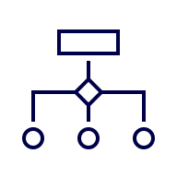

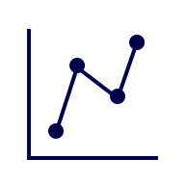
User Journey:
Presence
From First Click to Verified Record
UK, Singapore, Thailand, Taiwan
LogChain:
Built for people. Designed for progress.
Whether you’re Adam, Bob, or Claire, LogChain simplifies your day.
9× increase in productivity
90% reduction in data footprint and emissions
50%–55% cut in shipment processing time
Full digital traceability from origin to arrival
Industry recognition from Lloyd’s, UN ESCAP, UK Government, Logistics Middle East, IBM Z
Proof
Create a Shipment
Start with a single workflow: define goods, parties, permissions.
Capture Documents Digitally
Upload, scan, or fill forms on mobile or web. Includes e-signing, inspections, certifications.
Assign Roles & Permissions
Everyone sees only what they need — no version control chaos.
Trigger Smart Workflows
Tasks auto-route for approvals, audits, and regulatory steps.
Verify in Real Time
Blockchain secures each event. You always know who did what, when.
Sync or Export to Your System
Push data to ERP, customs, or trade finance tools via API.
Proven Adoption: User-friendly interfaces validated through real-world use
Seamless Integration: Works with existing systems — no rip-and-replace
Real-Time Visibility: One source of truth across every stakeholder
Blockchain Audit Trails: Secure, immutable, regulator-trusted
Workflow Automation: Reduces manual work, increases team productivity
Human-Centred Design: Built for operators, managers, and executives alike
Partnerships
Notes:
Start with a shipment.
Capture documents digitally.
Assign roles and permissions.
Trigger workflows automatically.
Verify every action in real time.
Sync data back into existing systems.

Slide 20











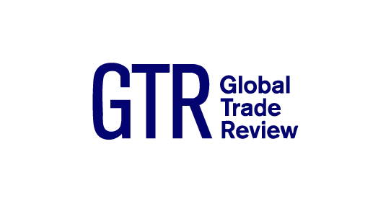
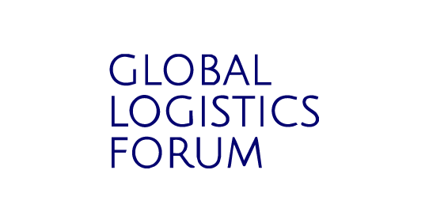

User Journey:
From First Click to Verified Record
Whether you’re Adam, Bob, or Claire, LogChain simplifies your day.
Create a Shipment
Start with a single workflow: define goods, parties, permissions.
Capture Documents Digitally
Upload, scan, or fill forms on mobile or web. Includes e-signing, inspections, certifications.
Assign Roles & Permissions
Everyone sees only what they need — no version control chaos.
Trigger Smart Workflows
Tasks auto-route for approvals, audits, and regulatory steps.
Verify in Real Time
Blockchain secures each event. You always know who did what, when.
Sync or Export to Your System
Push data to ERP, customs, or trade finance tools via API.
Presence
UK, Singapore, Thailand, Taiwan
9× increase in productivity
90% reduction in data footprint and emissions
50%–55% cut in shipment processing time
Full digital traceability from origin to arrival
Industry recognition from Lloyd’s, UN ESCAP, UK Government, Logistics Middle East, IBM Z
Proof
Partnerships
LogChain’ s application is strongly aligned with my original hopes for the blockchain. Their no-nonsense focus on delivering verifiable outcomes, rather than chasing attention, is both rare and refreshing. It’s a strong example of how blockchain can quietly enable trust in systems that matter.
— Scott Stornetta, Co-Inventor of Blockchain
Notes:
We work with governments, enterprises, and institutions.
We test in live pilots, not controlled demos.
We measure outcomes — productivity, speed, emissions, traceability.
Emphasis
This is evidence-led digitalisation.

Slide 21




Products:
From Principle to Practice
LogChain’s products address different moments in the trade journey — from understanding reality, to executing faster, to seeing risk early, to protecting outcomes that must stand up to scrutiny.
Enablers for Foundation
Value-Add
Efficiency
Info & Security
Portolan
Mapping today’s trade reality to unlock tomorrow’s digital operations
Prometheus
Intelligent automation for streamlined trade documentation
Argus
Real-time visibility and assurance across trade corridors
Cerberus
Enterprise-grade protection for secure, compliant digital trade
Presence
UK, Singapore, Thailand, Taiwan
LogChain’ s application is strongly aligned with my original hopes for the blockchain. Their no-nonsense focus on delivering verifiable outcomes, rather than chasing attention, is both rare and refreshing. It’s a strong example of how blockchain can quietly enable trust in systems that matter.
9× increase in productivity
90% reduction in data footprint and emissions
50%–55% cut in shipment processing time
Full digital traceability from origin to arrival
Industry recognition from Lloyd’s, UN ESCAP, UK Government, Logistics Middle East, IBM Z
Proof
Partnerships
— Scott Stornetta, Co-Inventor of Blockchain

Slide 22
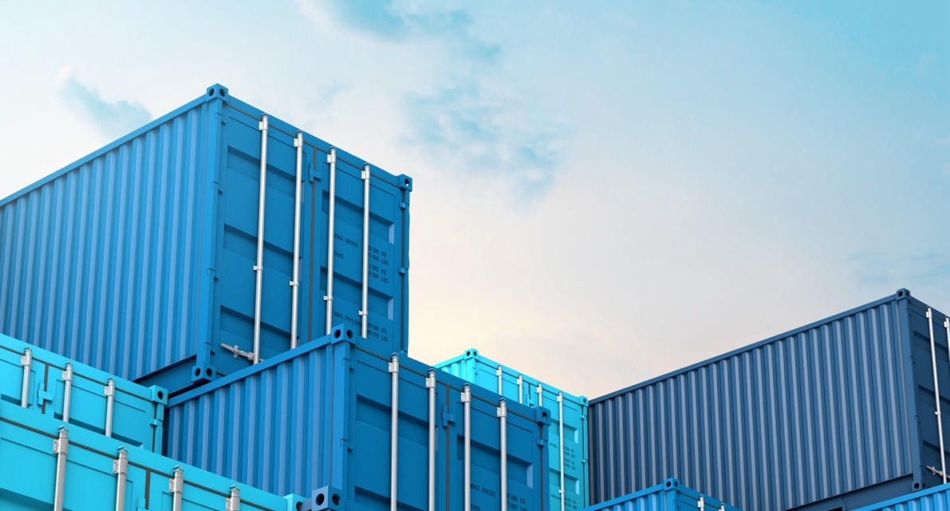
LogChain’ s application is strongly aligned with my original hopes for the blockchain. Their no-nonsense focus on delivering verifiable outcomes, rather than chasing attention, is both rare and refreshing. It’s a strong example of how blockchain can quietly enable trust in systems that matter.
— Scott Stornetta, Co-Inventor of Blockchain
“Absolutely revolutionary in terms of efficiency, sustainability and reduction of waste.”
— Kara Owen, British
High Commissioner to Singapore
“Andrew’s (CEO, LogChain) underlying skill is actually one of driving change management in the broadest sense, starting with the people.”
— Simon Middlebrough, CEO, SAESL
Trusted by Leaders,
Endorsed by Experts.
“LogChain’s leadership… in delivering is a testament to the power of innovation and collaboration… to scale and transform the future of trade.”
— Adam LG Ring, Global Head,
IBM Z ScaleUp Program
“Clear communication from LogChain created trust and understanding… going from ‘boardroom to the warehouse’.”
— Big C case study, UK–SEA
Trade Digitalisation Pilots report
“LogChain’s work in trade digitalisation is a shining example of how trusted, data-centric platforms can unlock the future of global trade.”
— Dr Melissa Sassi,
IBM-MachineLab Ventures
Notes:
Recognition from industry, government, and technology partners.
Trust comes from delivery, not claims.

Slide 23


Pilots to prove value
can be arranged in days…
not months
Arrange a demo today
We’re not starting from zero.
We’re starting from proof.
Notes:
Digital trade works.
The question now is where and how to scale responsibly.
That’s what LogChain focuses on next.
Pilots can be arranged in days, not months.
Focused, low-risk, and measurable.
Designed to prove value quickly.
Close line
“LogChain helps organisations move from intent to impact — with clarity, confidence, and credibility.”

Slide 24
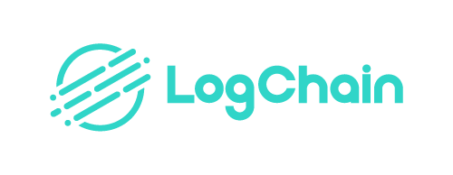
Be bold.
Be curious.
Get involved.
thelogchain.com

Slide 25
Product Roadmap:
From Principle to Practice
LogChain’s products address different moments in the trade journey — from understanding reality, to executing faster, to seeing risk early, to protecting outcomes that must stand up to scrutiny.
Enablers for Foundation
Value-Add
Efficiency
Info & Security
Portolan
Mapping today’s trade reality to unlock tomorrow’s digital operations
Prometheus
Intelligent automation for streamlined trade documentation
Argus
Real-time visibility and assurance across trade corridors
Cerberus
Enterprise-grade protection for secure, compliant digital trade
Notes:
Portolan maps today’s reality.
Prometheus automates documentation and workflows.
Argus provides visibility and early signals.
Cerberus protects high-trust data.
Important
Modular by design.
Adopt what you need, when you need it.

